Slide 1
CLUSTERING CUSTOMER SEGMENTATION
Data Science Project

Slide 2
Project Objectives
EDA
Model Building
Model Evaluation and Feedback
Deployment
Final Presentation

Slide 3
Steps of the project
Data Cleaning
Feature Engineering
Outlier Detection
Data Scaling
Dimensionality Reduction
Clustering
Visualization after clustering
Model Building
Final Model Building
Deployment

Slide 4
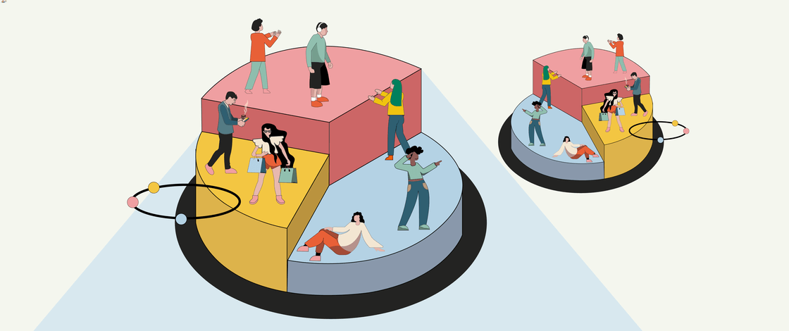
INtroduction

Slide 5
Customer personality analysis
Customer Personality Analysis is a detailed analysis of a company’s ideal customers. It helps a business to better understand its customers and makes it easier for them to modify products according to the specific needs, behaviors and concerns of different types of customers. Customer personality analysis helps a business to modify its product based on its target customers from different types of customer segments.

Slide 6
features
People
ID: Customer's unique identifier
Year_Birth: Customer's birth year
Education: Customer's education level
Marital_Status: Customer's marital status
Income: Customer's yearly household income
Kidhome: Number of children in customer's household
Teenhome: Number of teenagers in customer's household
Dt_Customer: Date of customer's enrollment with the company
Recency: Number of days since customer's last purchase
Complain: 1 if the customer complained in the last 2 years, 0 otherwise
Products
MntWines: Amount spent on wine in last 2 years
MntFruits: Amount spent on fruits in last 2 years
MntMeatProducts: Amount spent on meat in last 2 years
MntFishProducts: Amount spent on fish in last 2 years
MntSweetProducts: Amount spent on sweets in last 2 years
MntGoldProds: Amount spent on gold in last 2 years

Slide 7
features
Promotion
NumDealsPurchases: Number of purchases made with a discount
AcceptedCmp1: 1 if customer accepted the offer in the 1st campaign, 0 otherwise
AcceptedCmp2: 1 if customer accepted the offer in the 2nd campaign, 0 otherwise
AcceptedCmp3: 1 if customer accepted the offer in the 3rd campaign, 0 otherwise
AcceptedCmp4: 1 if customer accepted the offer in the 4th campaign, 0 otherwise
AcceptedCmp5: 1 if customer accepted the offer in the 5th campaign, 0 otherwise
Response: 1 if customer accepted the offer in the last campaign, 0 otherwise
Place
NumWebPurchases: Number of purchases made through the company’s website
NumCatalogPurchases: Number of purchases made using a catalogue
NumStorePurchases: Number of purchases made directly in stores
NumWebVisitsMonth: Number of visits to company’s website in the last month

Slide 8
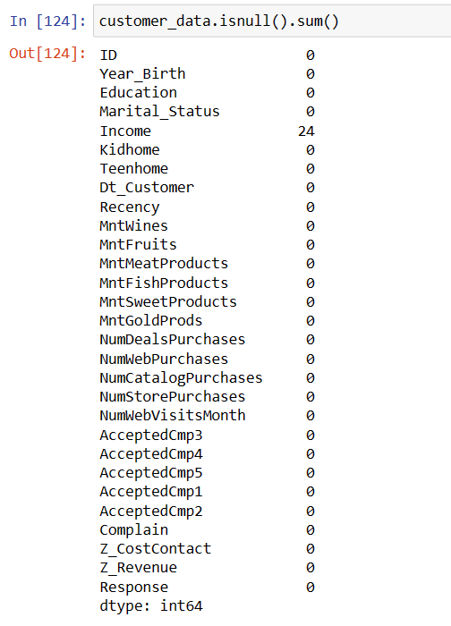
Data cleaning
There are 24 null values in Income column so we remove them

Slide 9
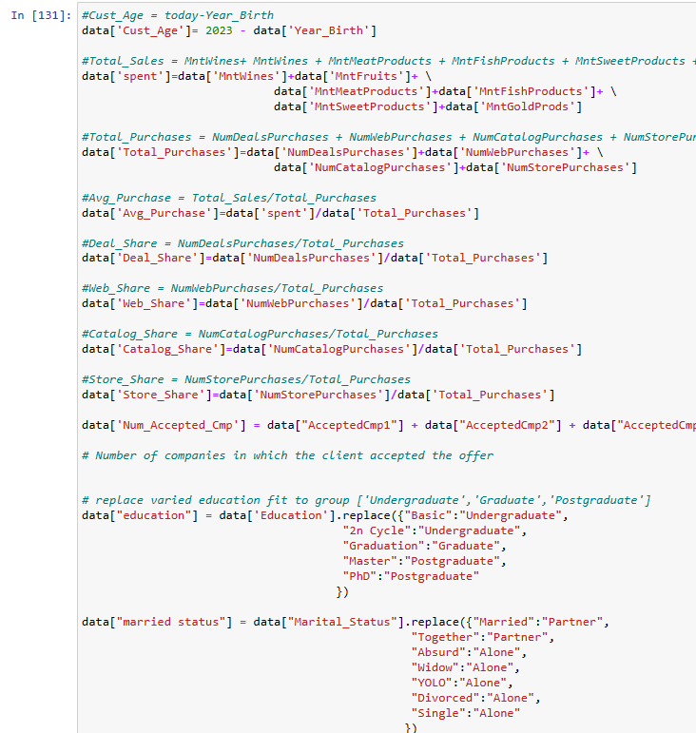

Feature engineering
We find Customer age
We find total spent by adding all product spent
We find shares of different types of buying options like deal, web, catalog and store
We find total number of accepted campaigns
We reduce education into 3 types: Undergraduate, Graduate and Post Graduate
We reduce marital status to Alone and Partner

Slide 10
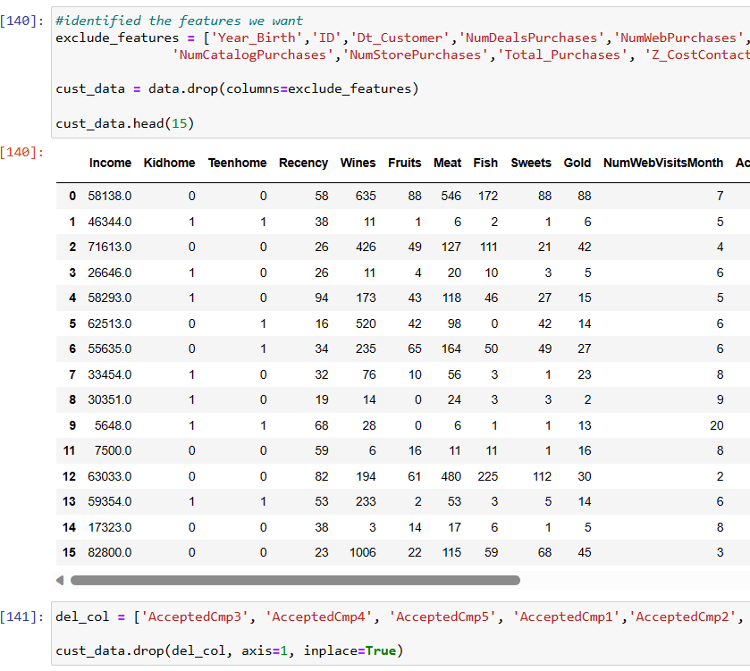
Feature engineering
Here we exclude the features or columns which are not necessary
Like ID AcceptedCmp1, Z_Cost etc

Slide 11
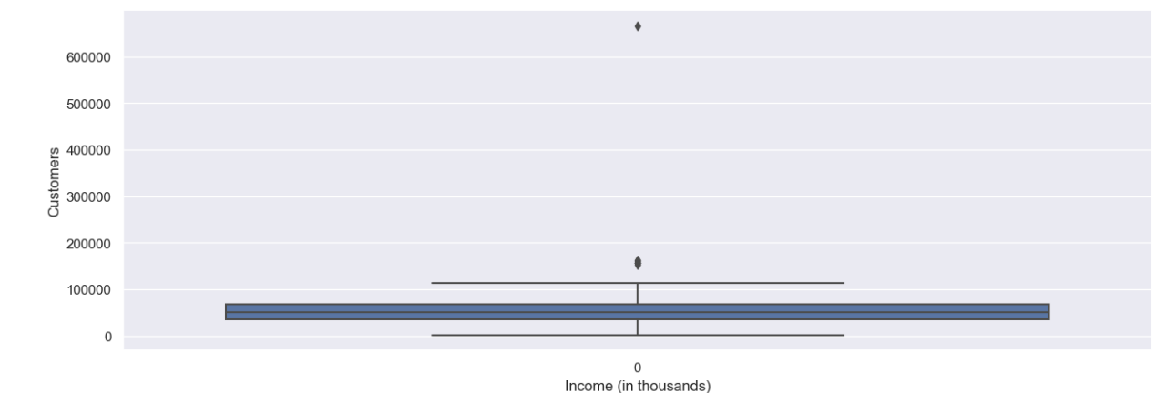
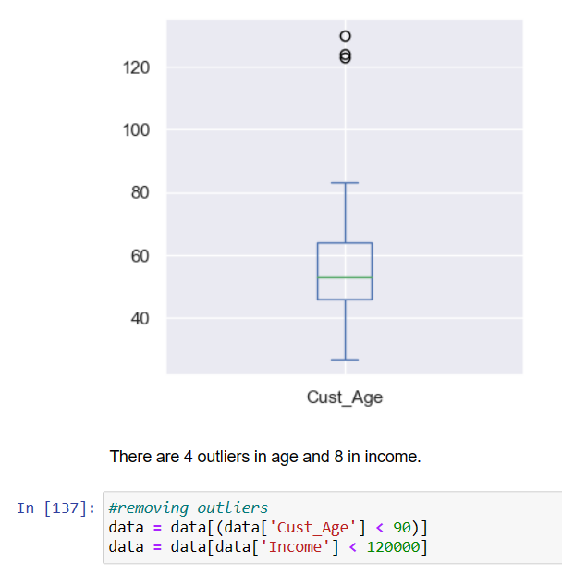
Outlier Detection
Income column
Customer age column

Slide 12
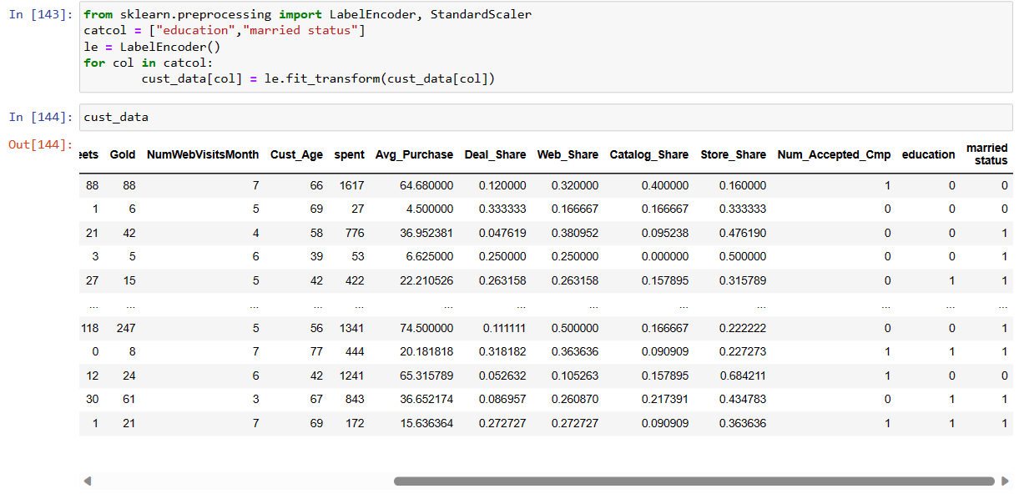
LAbel encoding
Here we encode education and married status.
For education
0 for Graduation
1 for Post Graduation
2 for Under Graduation
For married status
0 for Alone
1 for Partner

Slide 13
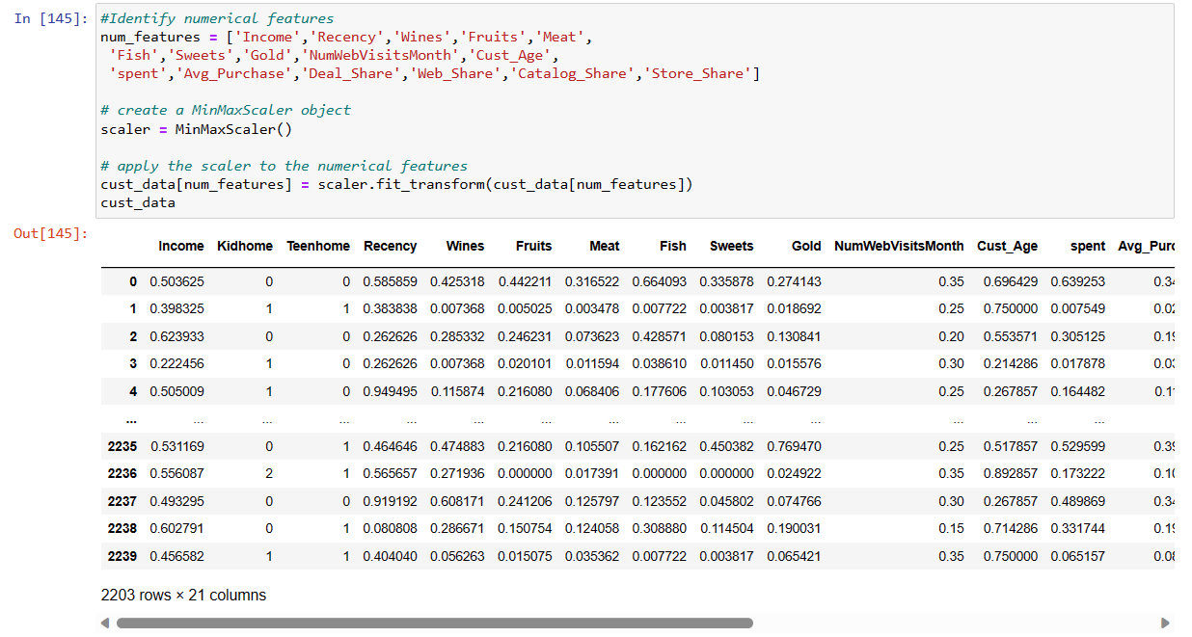
Data scaling
We use Minmax scaler to scale selected columns.

Slide 14
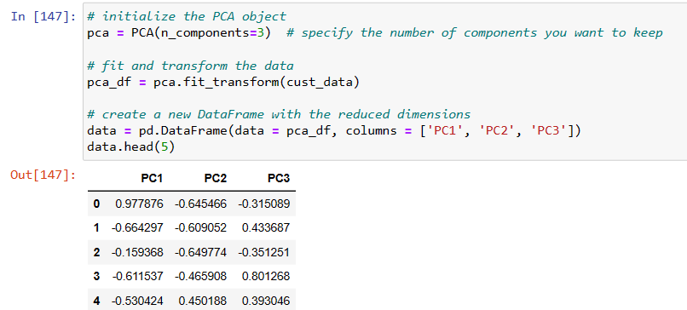
Dimensionality Reduction
We will conduct dimensionality reduction primarily for the purpose of visualizing my data. To do this, we will use PCA.
PCA, or Principal Component Analysis, is a statistical technique used for dimensionality reduction. It helps to reduce the number of variables in a dataset while preserving as much of the original variation in the data as possible.

Slide 15
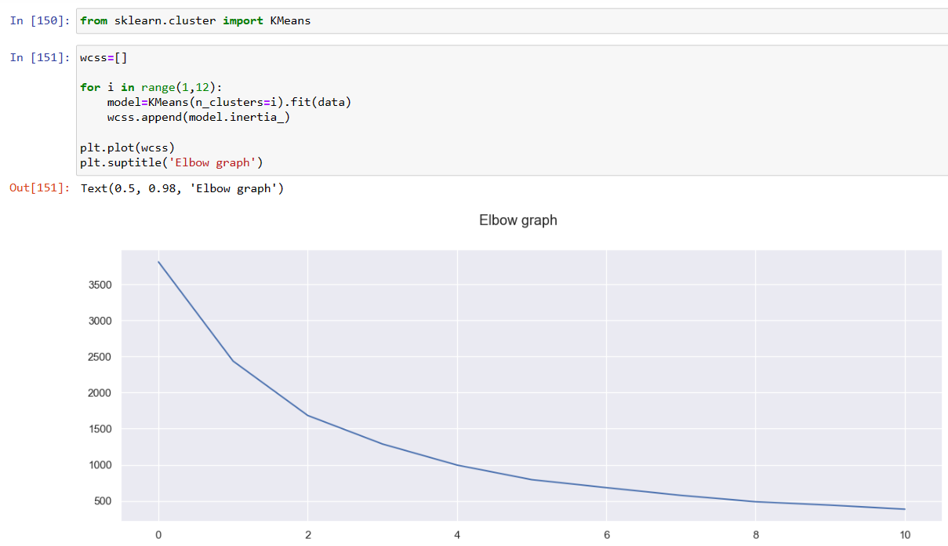
CLustering
Elbow Method
The elbow method is a graphical representation of finding the optimal ‘K’ in a K-means clustering. It works by finding WCSS (Within-Cluster Sum of Square) i.e. the sum of the square distance between points in a cluster and the cluster centroid.
The elbow graph shows WCSS values(on the y-axis) corresponding to the different values of K(on the x-axis). When we see an elbow shape in the graph, we pick the K-value where the elbow gets created. We can call this point the Elbow point. Beyond the Elbow point, increasing the value of ‘K’ does not lead to a significant reduction in WCSS.

Slide 16
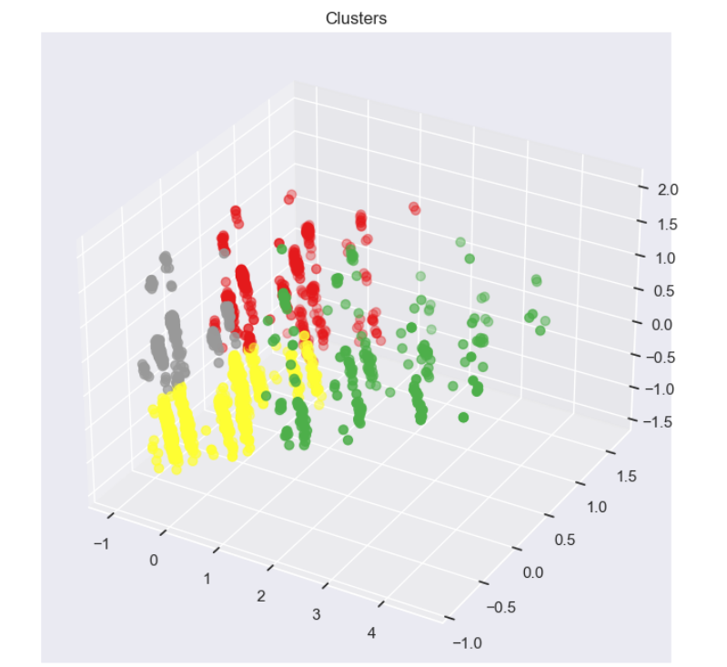
Clusters shown in 3d model

Slide 17
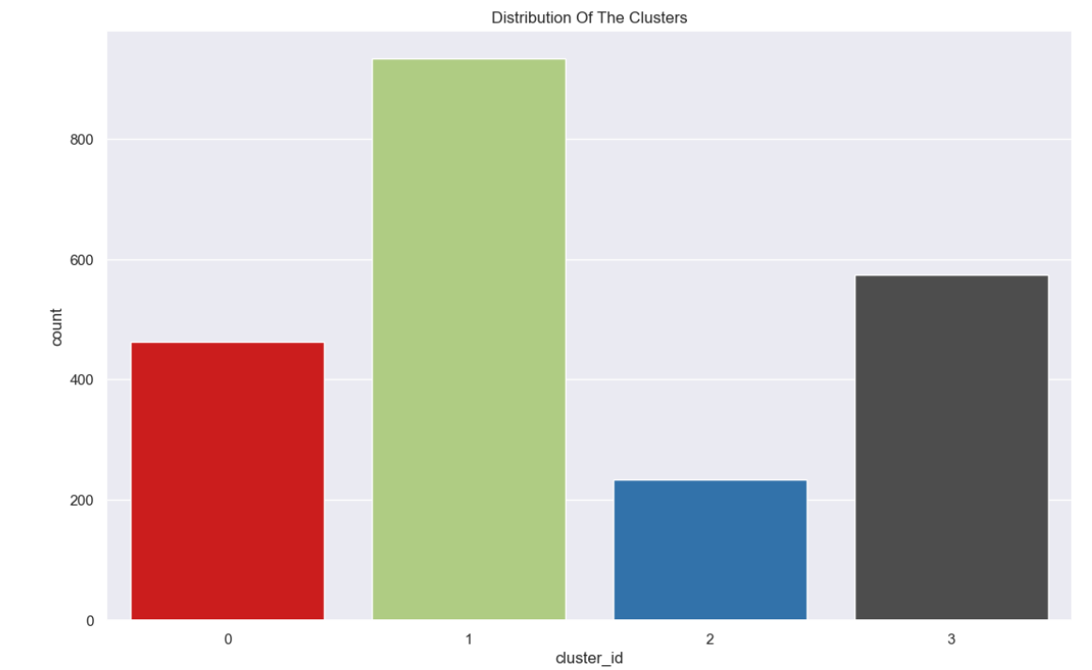
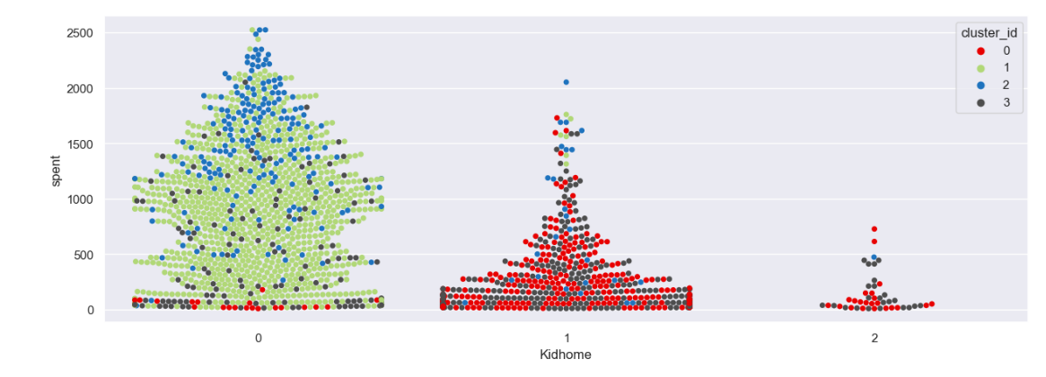
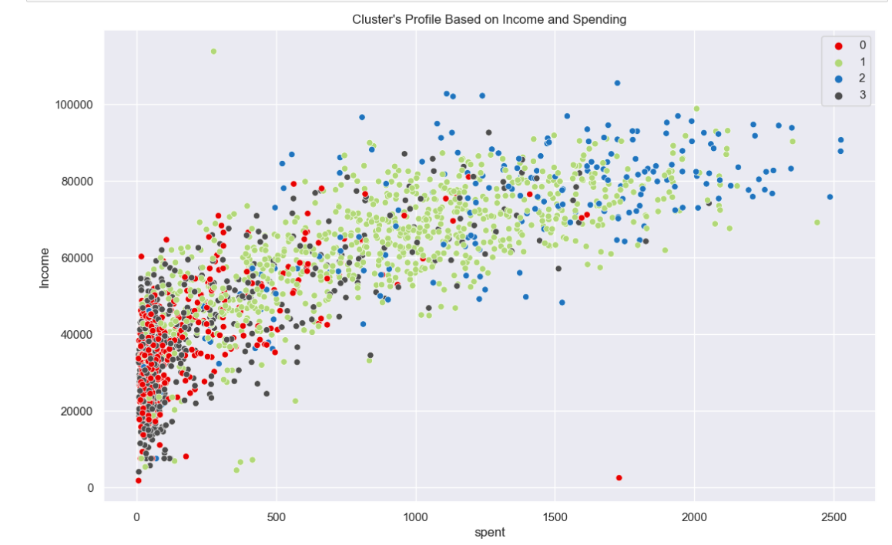
VISUALIZATIONS BASED ON CLUSTERS
NUMBER OF DATA IN CLUSTERS
INCOME VS SPENDING
NUMBER OF KIDS IN HOME

Slide 18
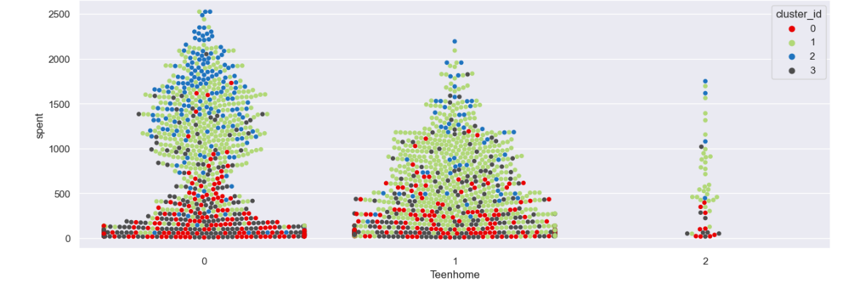
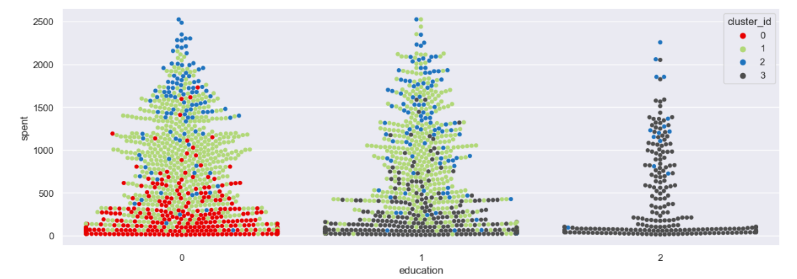
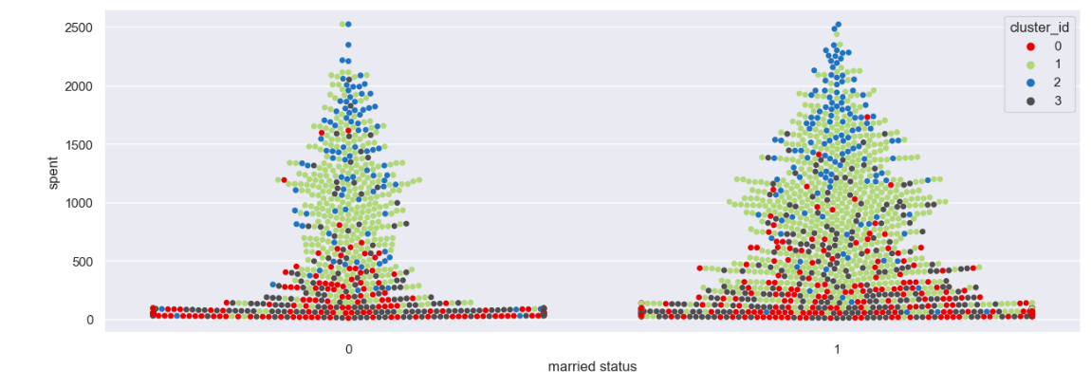
VISUALIZATIONS BASED ON CLUSTERS
NUMBER OF TEENS IN HOME
MARITAL STATUS
EDUCATIONAL QUALIFICATION

Slide 19
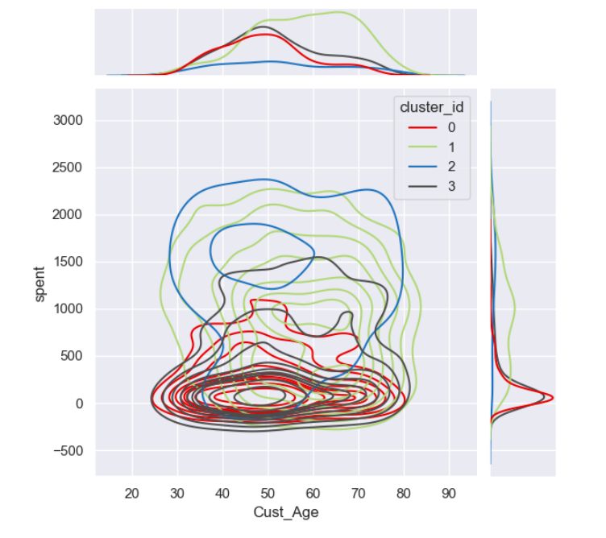
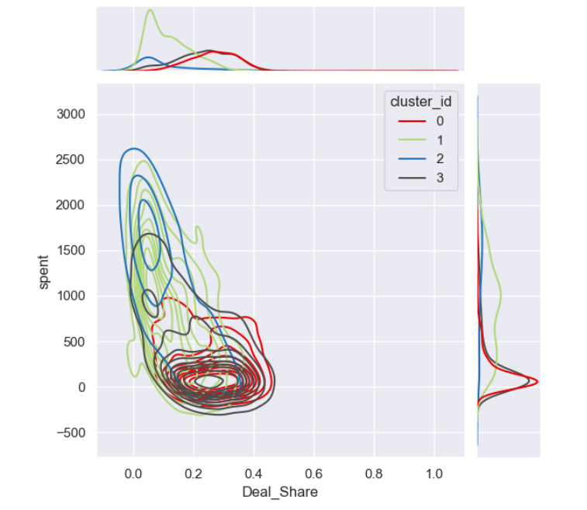
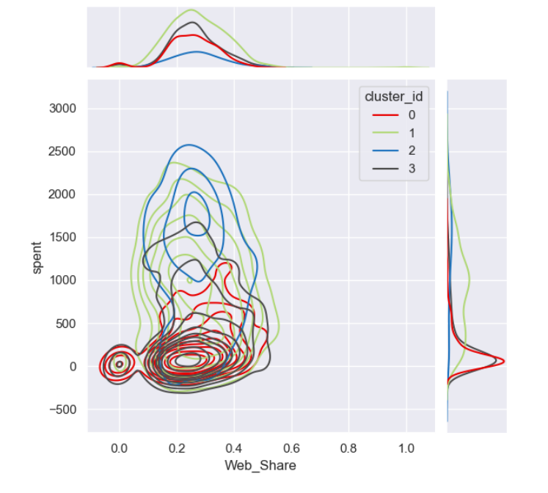
VISUALIZATIONS BASED ON CLUSTERS
WEB SHARE
AGE OF THE CUSTOMERS
DEAL SHARE

Slide 20
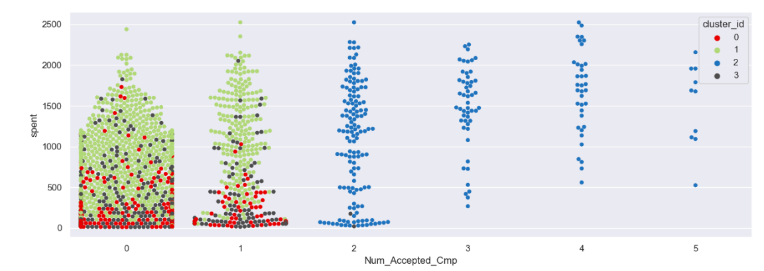
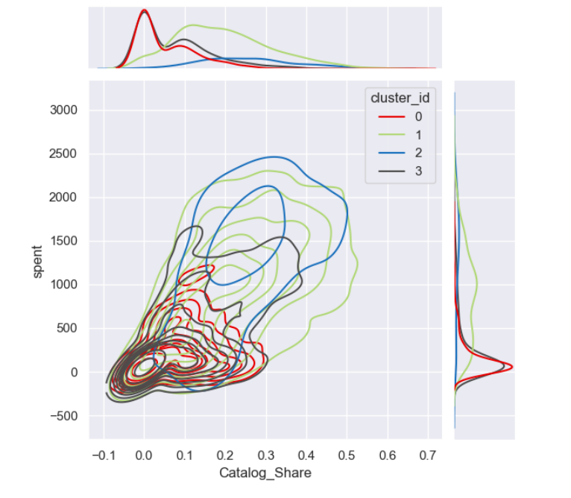
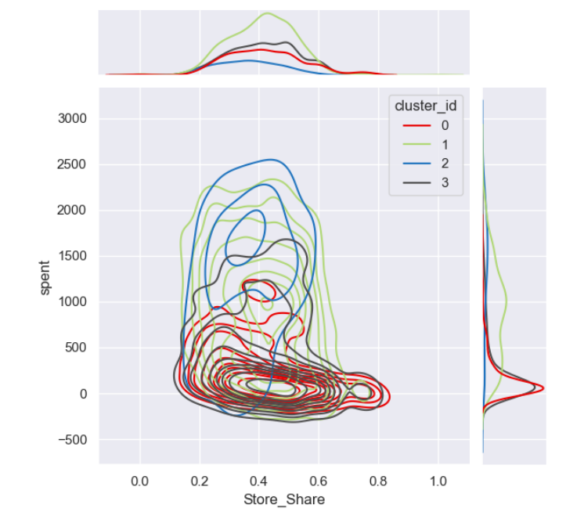
VISUALIZATIONS BASED ON CLUSTERS
CATALOG SHARE
STORE SHARE
NUMBER OF ACCEPTED CAMPAIGNS

Slide 21
Conclusions based on clustering
CLUSTER 0 | CLUSTER 1 | CLUSTER 2 | CLUSTER 3
AVERAGE NUMBER OF PEOPLE | HIGHEST NUMBER OF PEOPLE | LOWEST NUMBER OF PEOPLE | AVERAGE NUMBER OF PEOPLE
AVERAGE INCOME AND LOW SPENDING | AVERAGE INCOME AND AVERAGE SPENDING | HIGH INCOME AND HIGH SPENDING | LOW INCOME AND LOW SPENDING
HAS ONE KID AND ATMOST ONE TEEN | HAS NO KIDS AND ATMOST TWO TEENS | HAS ATMOST ONE KID AND ATMOST ONE TEEN | HAS ATMOST TWO KIDS AND ATMOST ONE TEEN
HAS GRADUATE PEOPLE | HAS BOTH GRADUATE AND POSTGRADUATE | HAS ALL TYPES | HAS UNDERGRADUATE AND POSTGRADUATE
MIDDLE AGE PEOPLE | OLD AGE PEOPLE | BOTH MIDDLE AND OLD AGE PEOPLE | BOTH MIDDLE AND OLD AGE PEOPLE
LOW DEAL SHARE AND CATALOG SHARE | HIGH DEAL SHARE AND CATALOG SHARE | HIGH DEAL SHARE AND CATALOG SHARE | LOW DEAL SHARE AND CATALOG SHARE
ATMOST ACCEPTED ONE CAMPAIGN OFFER | ATMOST ACCEPTED ONE CAMPAIGN OFFER | ATLEAST ACCEPTED TWO CAMPAIGN OFFER | ATMOST ACCEPTED ONE CAMPAIGN OFFER

Slide 22
MODEL BUILDING
WE USE DIFFERENT SUPERVISED LEARNING TECHNIQUES FOR MODEL BUILDING
LOGISTIC REGRESSION
NAÏVE BAYES
DECISION TREES
SUPPORT VECTOR MACHINES (SVM).
RANDOM FOREST
K-NEAREST NEIGHBORS (KNN)
IN EACH OF THE ABOVE TECHNIQUES WE USE TRAIN-TEST SPLIT.
OUR MODEL WILL BE WELL TRAINED ON TRAINING DATASET AND WE PREDICT THE RESULT USING TEST DATASET.

Slide 23
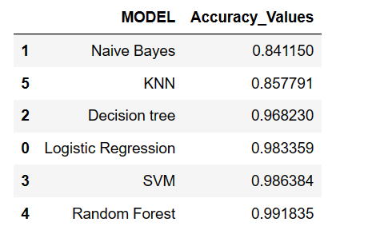
FINAL MODEL AND CONCLUSIONS
We see that Naive Bayes, KNN has low accuracy.
LR,SVM and RF has high accuracy so the problem of overfitting.
So we select Decision tree as final model.

Slide 24
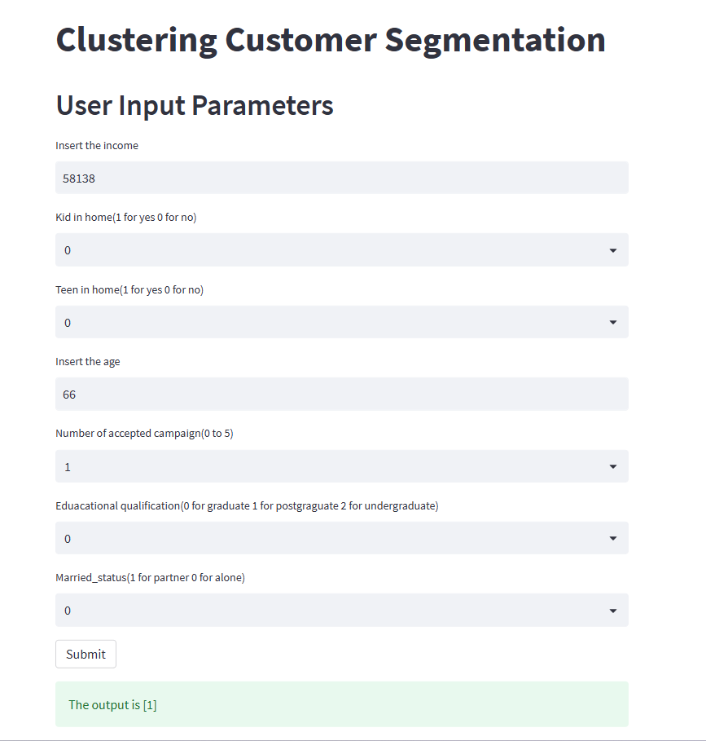
deployment

Slide 25

THANK YOU

